Slide 1

CS 584 Machine Learning
Instructor: Dr. Yan Yan
Email: yyan34@iit.edu

Slide 2
Course Information
Instructor: Dr. Yan Yan
Office: STUART 237C
Office hours: Wed 10:00am-11:00am or By appointment
Email: yyan34@iit.edu
Lecture: Wednesday / Friday 11:25am-12:40pm
Location: IIT Tower 1F6-1
TAs: handle all homework questions and python coding questions
Bin Xie, bxie9@hawk.iit.edu
Changchang Sun, csun39@hawk.iit.edu
Gai Hao, ghao3@hawk.iit.edu
Objective
An in-depth understanding of machine learning techniques and their applications in the computer vision, multimedia and other domains.
Use machine learning techniques to solve basic problems in our daily life.

Slide 3
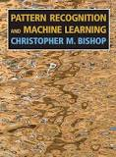
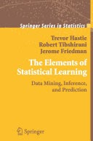

Course Information (Cont’d)
Course textbook
Pattern Recognition and Machine Learning,
by Christopher M. Bishop, 2006
The Elements of Statistical Learning: Data Mining, Inference, and Prediction (Second Edition),
by Trevor Hastie, Robert Tibshirani and Jerome Friedman, 2009
Deep Learning,
by Ian Goodfellow, Yoshua Bengio and Aaron Courville, 2016

Slide 4
Course Information (Cont’d)
Topics
Topic 1. Machine Learning Introduction [Slides]
Topic 2. Regression (Linear Regression) [Bishop Sec 3.1]
Topic 3. Bias and Variance [Bishop Sec 3.2]
Topic 4. Gradient Descent [Bishop Sec 5.2]
Topic 5. Classification [Bishop Sec 4.1]
Topic 6. Logistic Regression [Bishop Sec 4.3.2]
Topic 7. Deep Learning Introduction [Bishop Sec 5.1]
Topic 8. Backpropagation [Bishop Sec 5.3]
Topic 9. Pytorch and Tensorflow
Topic 10. CNN / RNN [Slides / Papers]
Topic 11. Deep Learning Tips [Slides / Papers]
Topic 12. PCA [Slides]
Topic 13. Auto-encoder [Slides]
Topic 14. Semi-supervised Learning [Slides]
Topic 15. Transfer Learning [Slides]
Prerequisite
Knowledge of basic computer science principles and skills, at a level sufficient to write a reasonably non-trivial computer program.
Familiar with the basic probability theory and the basic linear algebra.

Slide 5
Course Information (Cont’d)
Machine learning is a math intensive class.
Grading
Assignments: 30%
Mid-term: 20%
Final Exam: 20%
Final Project: 30%
Bonus: 5% (if >80% student finish the evaluation, send email proof at the end of semester)
(Grades: A is 90+, B is 80+, C is 70+, D is 60+)
Course Materials
Blackboard

Slide 6
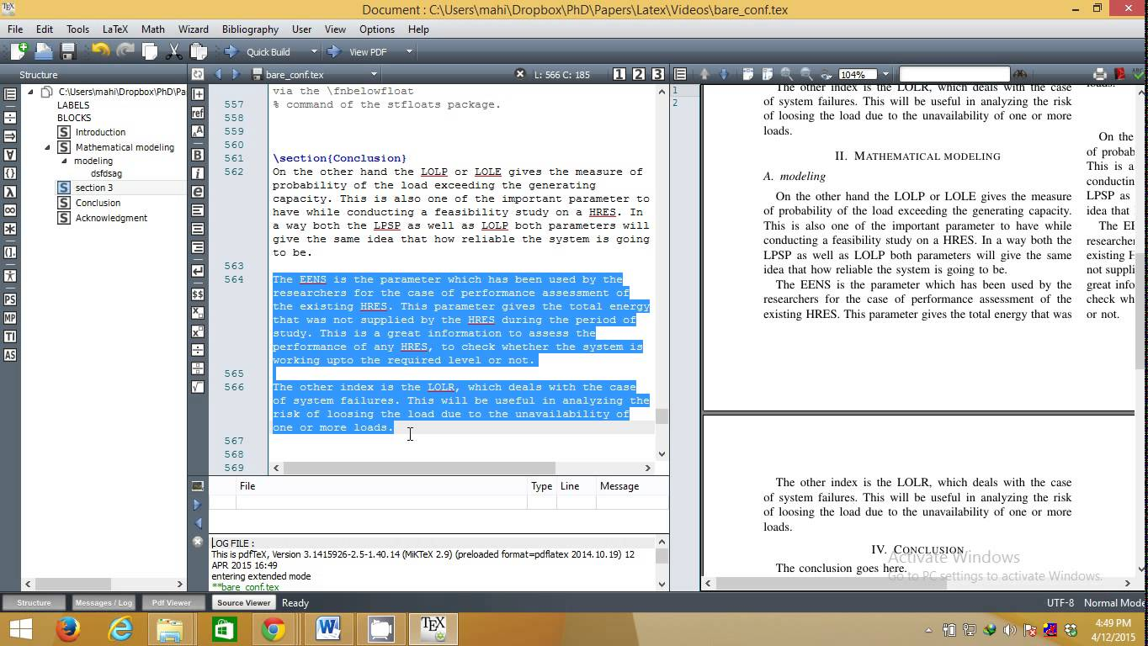
Course Information (Cont’d)
Programming language
Python
https://machinelearningmastery.com/machine-learning-in-python-step-by-step/
LaTex
You are strongly encouraged to use LaTex for the project proposal and reports.
https://www.overleaf.com/
GitHub
https://guides.github.com/activities/hello-world/
A centralized place to store and track all code related to your project.
A principled way to collaborate with team members.

Slide 7
Course Information (Cont’d)
Your expectations about this class:
Machine learning develops too fast in the recent years. We will cover the fundamental things in machine learning, not too many advanced topics.
We will balance between machine learning practice and theory, with a reasonable in-depth understanding for different machine learning models.
Who are suitable for this class?
People without any machine learning experience before (Yes)
People know something about basic machine learning models such as linear/logistic regression, but want to know more about other machine learning models (Yes)
Already involved in some machine learning projects and research focus on machine learning (No)

Slide 8
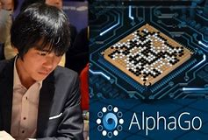
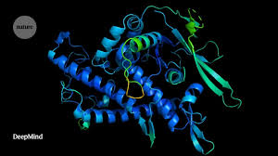
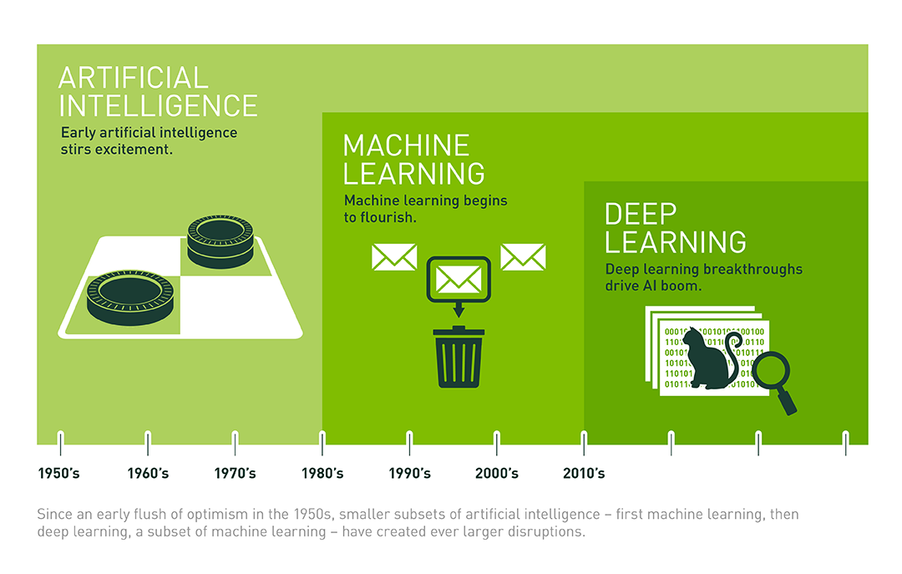
Machine Learning in Our Daily Life
The latest version of our AI system AlphaFold has been recognized as a solution to this grand challenge by the organizers of the biennial Critical Assessment of protein Structure Prediction (CASP). This breakthrough demonstrates the impact AI can have on scientific discovery and its potential to dramatically accelerate progress in some of the most fundamental fields that explain and shape our world.
AlphaGo is the first computer program to defeat a professional human Go player, the first program to defeat a Go world champion, and arguably the strongest Go player in history.

Slide 9
Machine Learning and Computer Vision Applications

Slide 10
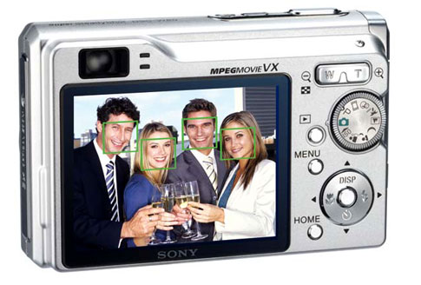
Face detection
Most digital cameras and smart phones detect faces - Canon, Sony, Fuji, …
For smart focus, exposure compensation, and cropping
Slide credit: Steve Seitz

Slide 11
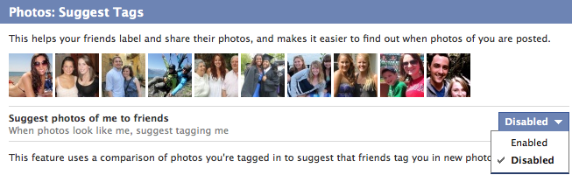
Face recognition
Facebook face auto-tagging

Slide 12
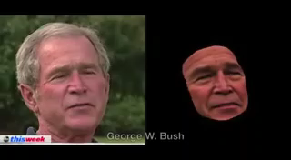
Face Landmark Alignment
What Makes Tom Hanks Look Like Tom Hanks ICCV 2015

Slide 13
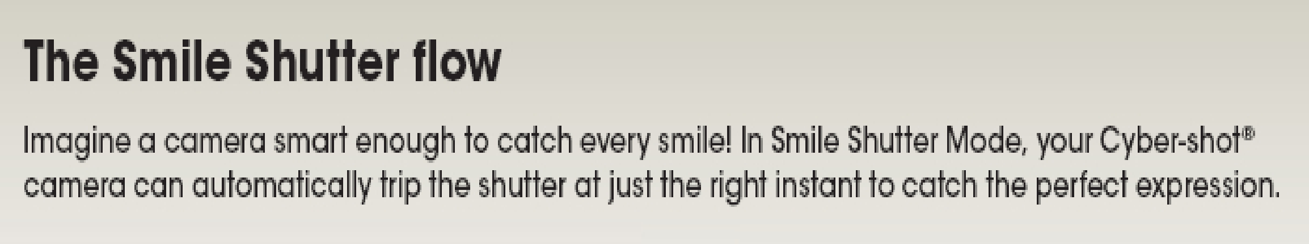
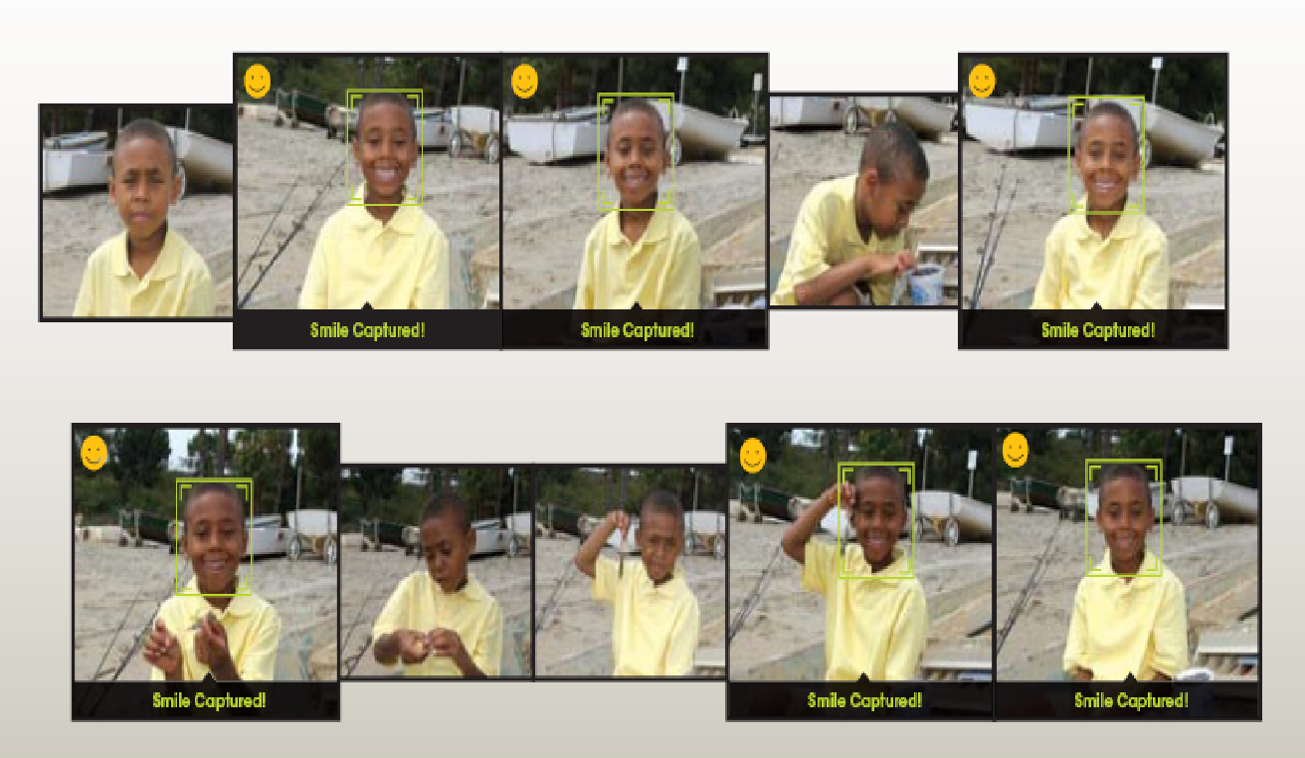
Smile Detection
Sony Cyber-shot® T70 Digital Still Camera
Slide credit: Steve Seitz

Slide 14
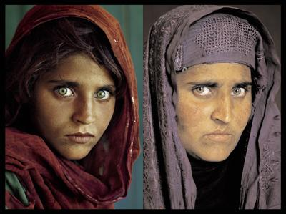
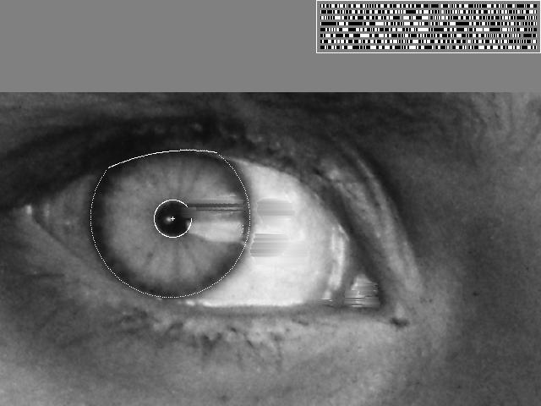
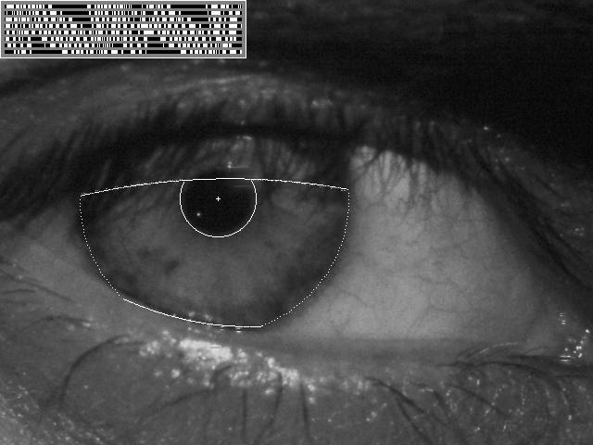
Vision-based Biometrics
“How the Afghan Girl was Identified by Her Iris Patterns”
Slide credit: Steve Seitz

Slide 15
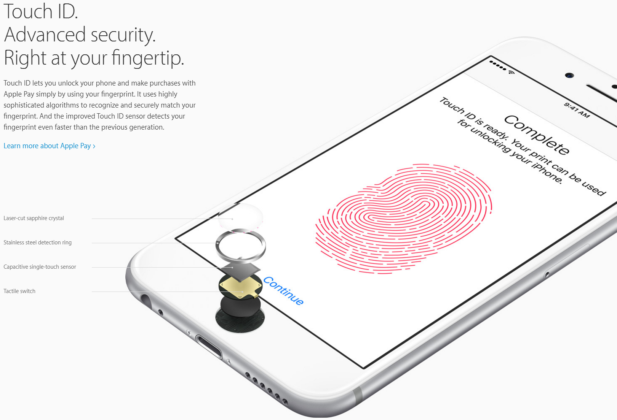
Vision-based Biometrics

Slide 16
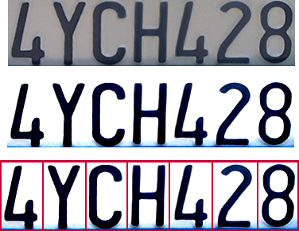
Optical Character Recognition (OCR)
Technology to convert scanned docs to text
If you have a scanner, it probably came with OCR software
Digit recognition, AT&T labs
http://www.research.att.com/~yann
License plate readers
http://en.wikipedia.org/wiki/Automatic_number_plate_recognition
Slide credit: Steve Seitz

Slide 17
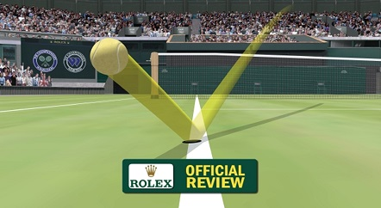
Computer vision in sports
Hawk-Eye: helping/improving referee decisions

Slide 18
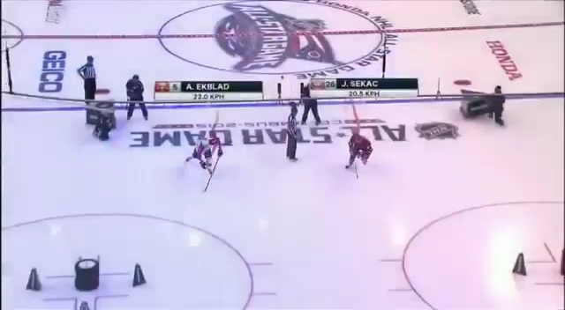
Computer vision in sports
Play tracking

Slide 19
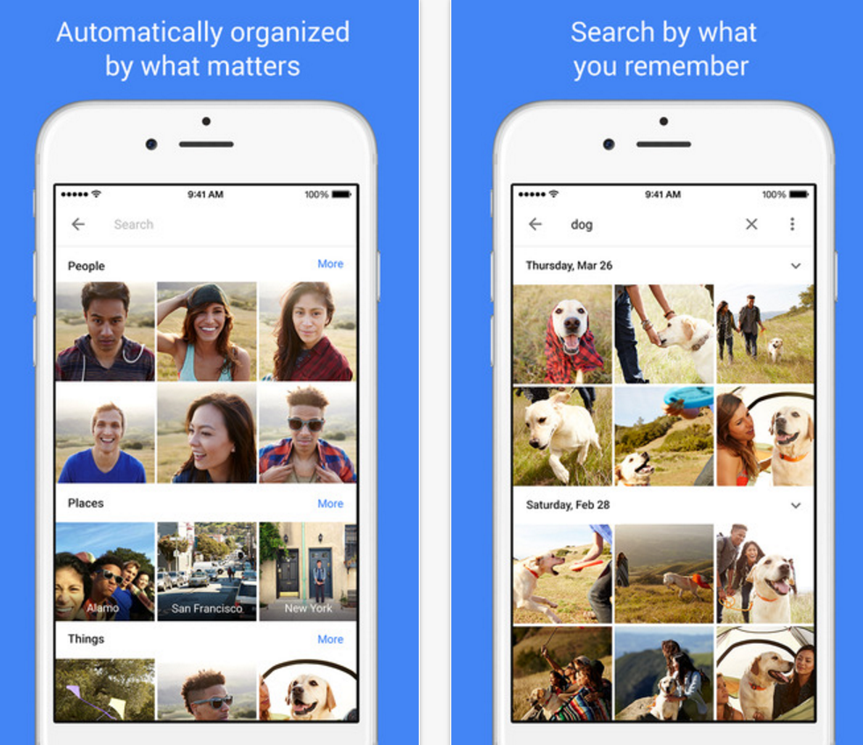
Visual recognition for photo organization
Google photo

Slide 20
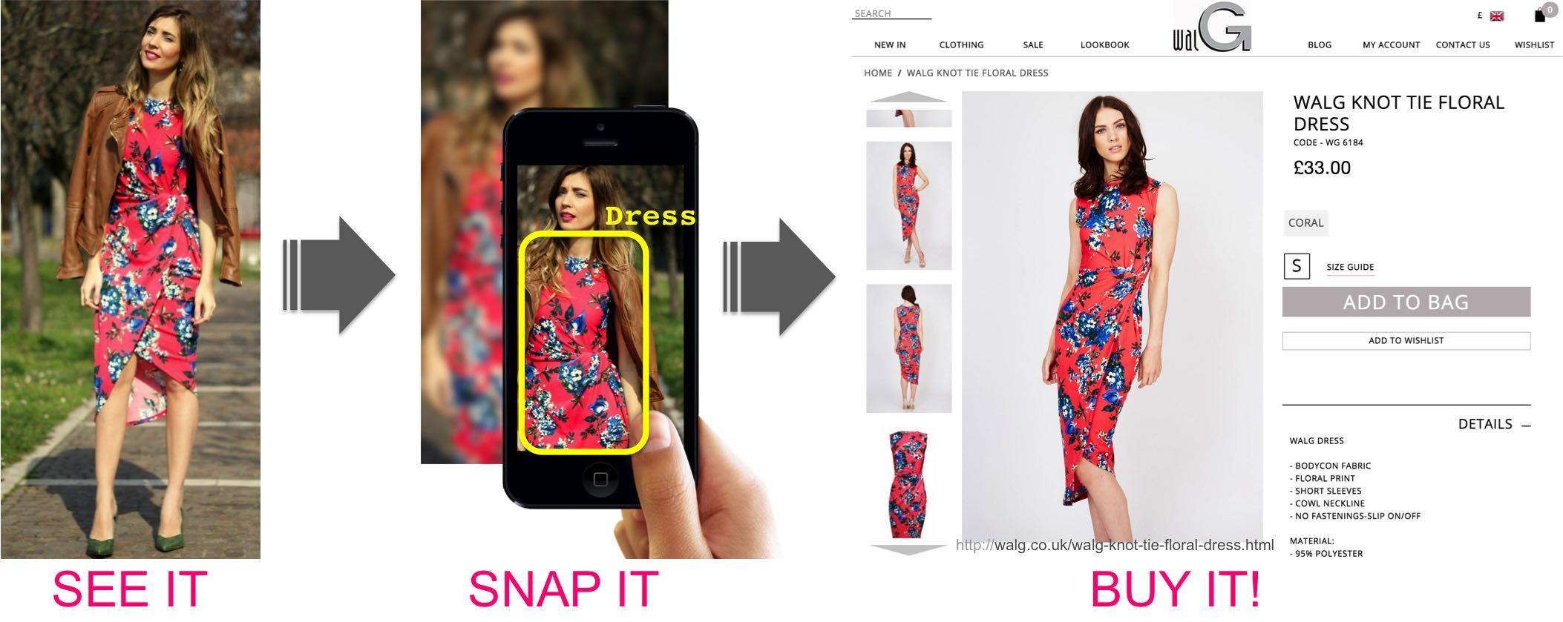
Matching street clothing photos in online Shops
Street2shop, ICCV 2015

Slide 21

3D scanner from a mobile camera
MobileFusion

Slide 22
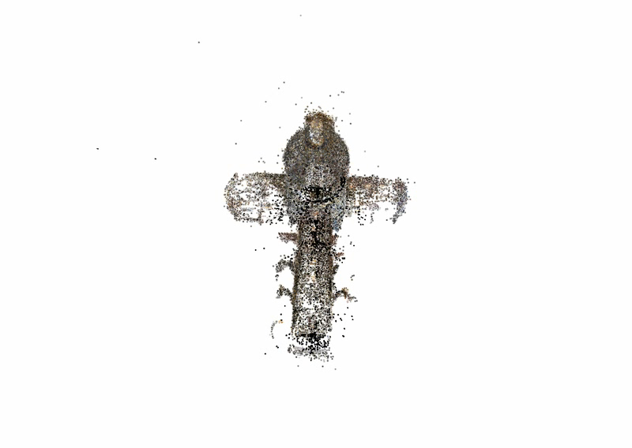
3D from thousands of images
Building Rome in a Day: Agarwal et al. 2009

Slide 23
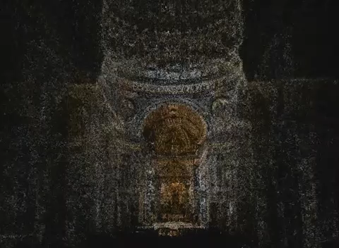
3D from thousands of images
[Furukawa et al. CVPR 2010]

Slide 24
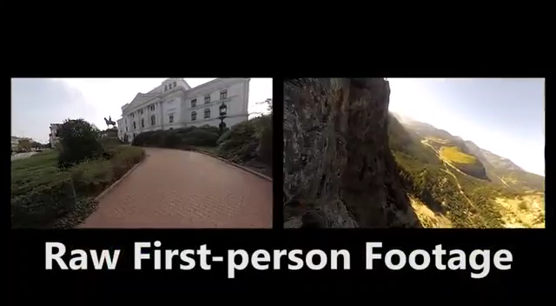
First-person Hyperlapse Videos
[Kopf et al. SIGGRAPH 2014]

Slide 25
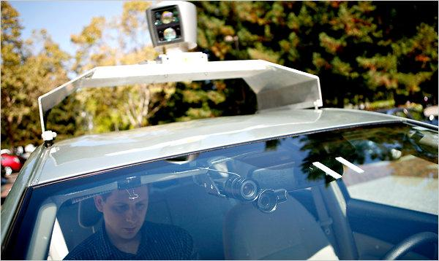
Google cars
Oct 9, 2010. "Google Cars Drive Themselves, in Traffic". The New York Times. John Markoff
June 24, 2011. "Nevada state law paves the way for driverless cars". Financial Post. Christine Dobby

Slide 26
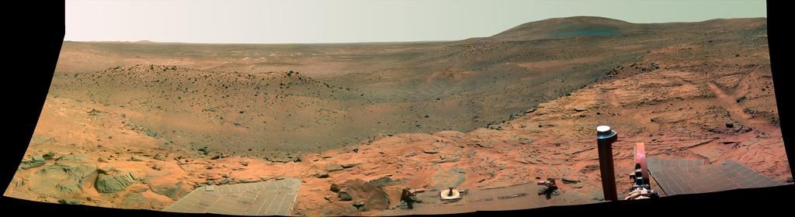
Vision in space
NASA'S Mars Exploration Rover Spirit captured this westward view from a low plateau where Spirit spent the closing months of 2007.
Vision systems (JPL) used for several tasks
Panorama stitching
3D terrain modeling
Obstacle detection, position tracking
For more, read “Computer Vision on Mars” by Matthies et al.

Slide 27
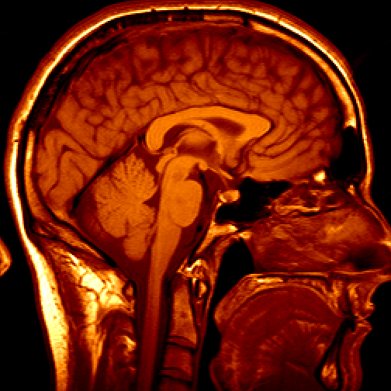
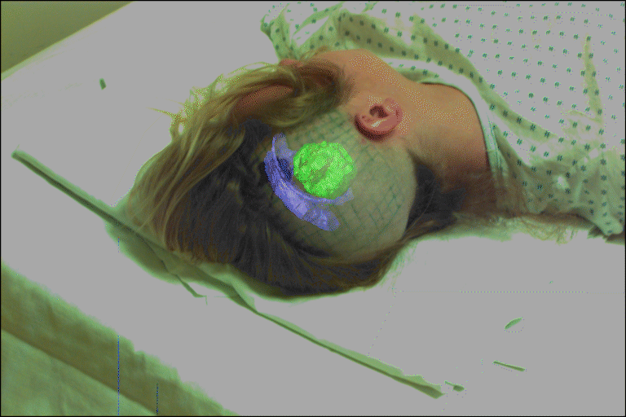
Medical imaging
Image guided surgery
Grimson et al., MIT
3D imaging
MRI, CT

Slide 28

Computer vision for healthcare
BiliCam, Ubicomp 2014

Slide 29
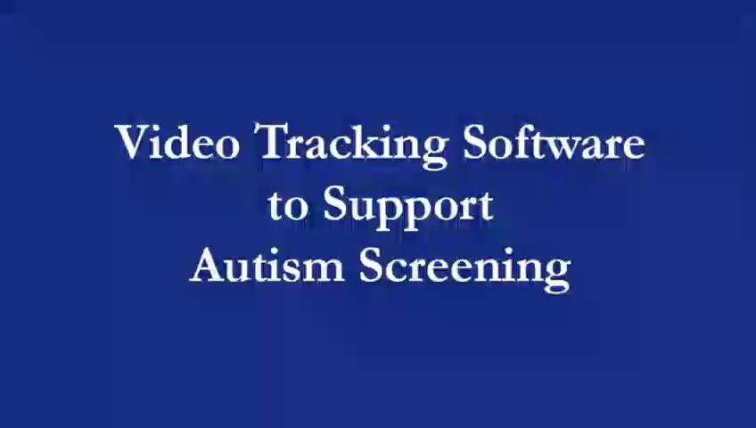
Computer vision for healthcare
Autism Screening

Slide 30
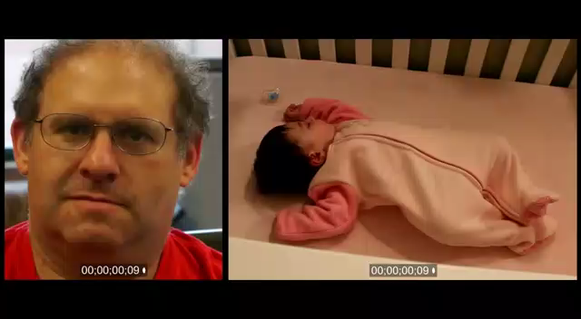
Computer vision for healthcare
Video magnification

Slide 31
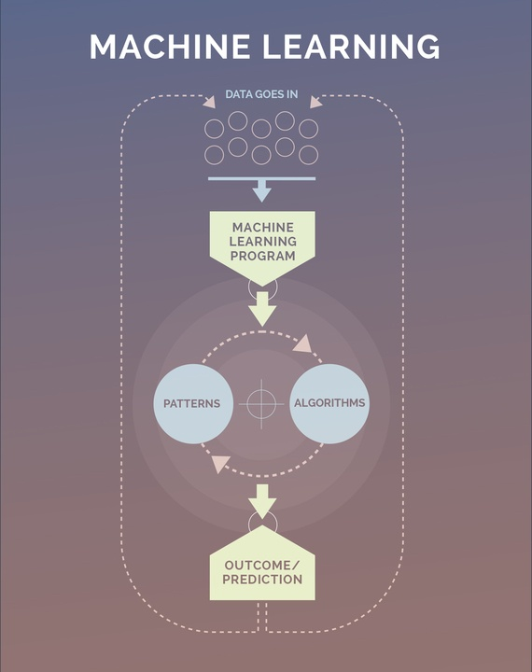
Machine Learning Framework

Slide 32
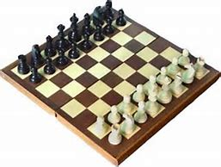
What is machine learning?
Machine Learning: Field of study that gives computers the ability to learn without being explicitly programmed. - Arthur Samuel (1959)
Well-posed Learning Problem: A computer program is said to learn from experience E with respect to some task T and some performance measure P, if its performance on T, as measured by P, improves with experience E. - Tom Mitchell (1998)

Slide 33
A computer program is said to learn from experience E with respect to some task T and some performance measure P, if its performance on T, as measured by P, improves with experience E.
Quiz
Suppose your email program watches which emails you do or do not mark as spam, and based on that learns how to better filter spam. What is the task T in this setting?
Classifying emails as spam or not spam.
Watching you label emails as spam or not spam.
The number (or fraction) of emails correctly classified as spam/not spam.
None of the above—this is not a machine learning problem.

Slide 34
Machine learning algorithms
Supervised learning
Unsupervised learning
Semi-supervised learning
Weakly-supervised learning
Multi-task learning
Transfer learning
……
We will also talk about practical advice for applying learning algorithms.

Slide 35
Supervised Learning
“right answers” given
Price $ in 1000’s
House Price Prediction
Regression
Size in square feet

Slide 36
Supervised Learning
“right answers” given
Breast Cancer (malignant, benign)
Malignant?
Tumor Size
Classification

Slide 37
Supervised Learning
“right answers” given
Breast Cancer (malignant, benign)
Age
Tumor Size
- Clump Thickness
- Uniformity of Cell Size
- Uniformity of Cell Shape
…

Slide 38
Quiz
You’re running a company, and you want to develop learning algorithms to address each of two problems.
Problem 1: You have a large inventory of identical items. You want to predict how many of these items will sell over the next 3 months.
Problem 2: You’d like software to examine individual customer accounts, and for each account decide if it has been hacked/compromised.
Should you treat these as classification or as regression problems?

Slide 39
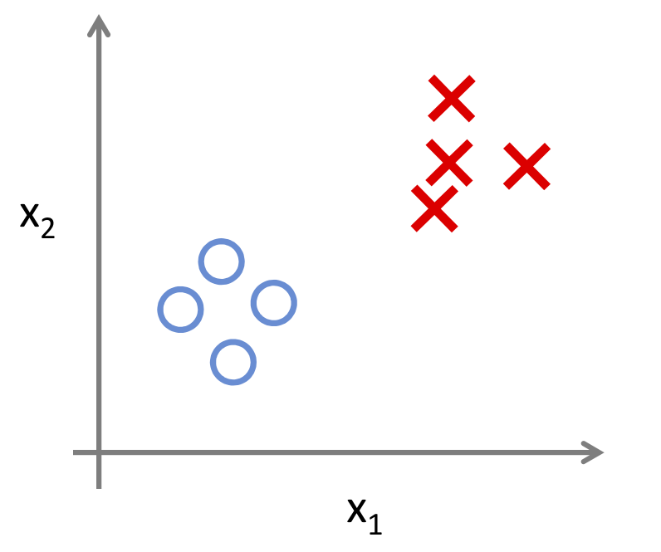

Unsupervised Learning
Supervised Learning
Unsupervised Learning

Slide 40
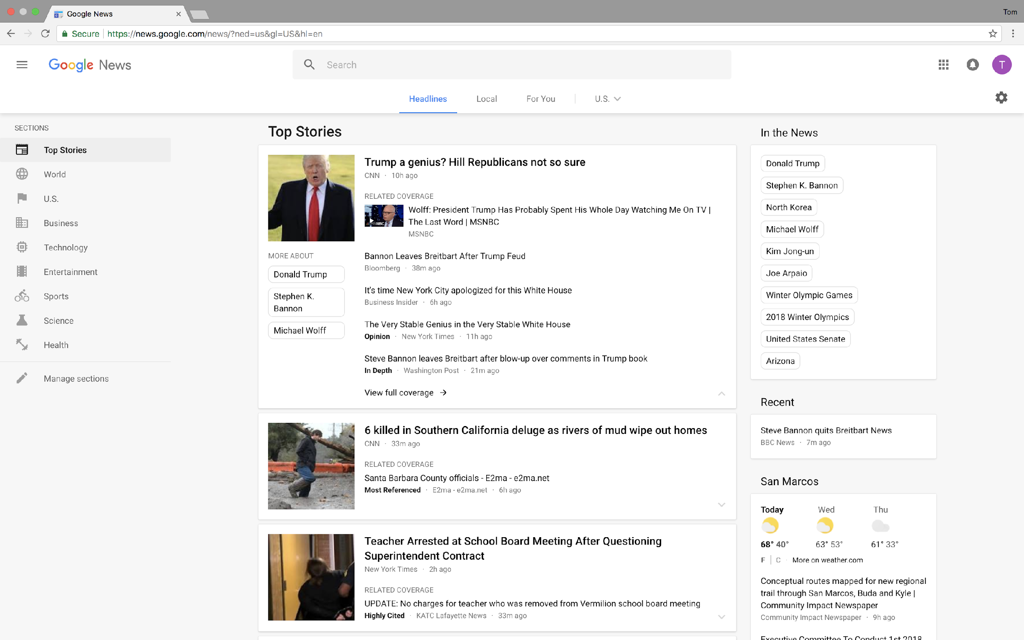
Google News

Slide 41
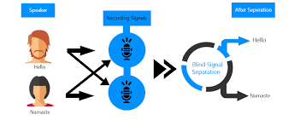

Cocktail Party Problem
Music Separation
Microphone #1
Microphone #2
Output #1
Output #2
Speech Separation
Microphone #1
Microphone #2
Output #1
Output #2
[W,s,v]=svd((repmat(sum(x.*x,1),size(x,1),1).*x)*x');

Slide 42
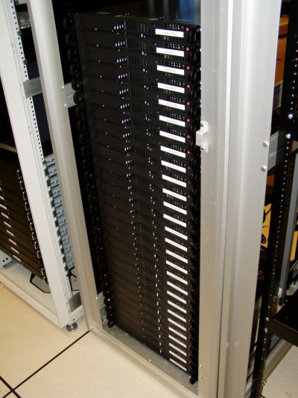
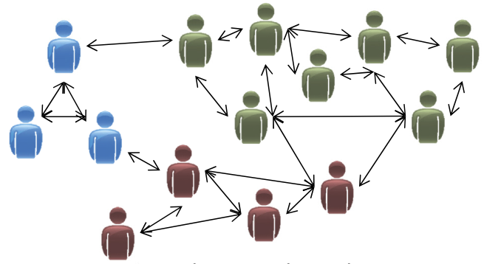
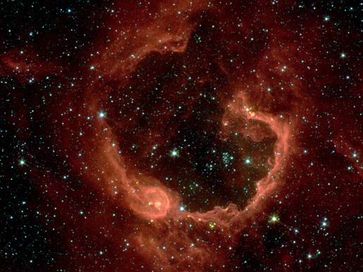
Applications
Organize computer clusters
Social network analysis
Astronomical data analysis

Slide 43
Quiz
Of the following examples, which would you address using an unsupervised learning algorithm? (Check all that apply.)
Given email labeled as spam/not spam, learn a spam filter.
Given a set of news articles found on the web, group them into
set of articles about the same story.
Given a database of customer data, automatically discover market
segments and group customers into different market segments.
Given a dataset of patients diagnosed as either having diabetes or
not, learn to classify new patients as having diabetes or not.

